Slide 1







Data Analyst Capstone Project
Alvin Paul Alegarbes
June 19, 2024

Slide 2



OUTLINE
Executive Summary
Introduction
Methodology
Results
Visualization – Charts
Dashboard
Discussion
Findings & Implications
Conclusion
Appendix

Slide 3

EXECUTIVE SUMMARY
Introduction: Identify current and emerging skills for programming and databases
Methodology – Overview of approach and techniques used
Data Collection: Source and process for gathering data
Data analysis: Methods applied to analyze the collected data
Visualization: Creating graphs to illustrate key trends
Results: Presentation of visuals and findings
Discussions: Interpretation of results
Conclusions: Summary of the project outcome

Slide 4

INTRODUCTION
Objective: Analyze future skill requirements in IT.
Data Sources: Job postings, training portals, surveys.
Data Collection: Scraping websites, accessing APIs, using CSV, Excel, and databases.
Focus: Top programming languages, database skills, popular IDES.
Preparation: Data wrangling for analysis.
Analysis: Apply statistical techniques to uncover trends.
Significance: Predict emerging IT skills and global trends.

Slide 5

METHODOLOGY
Collect data through API and Webscrapping
Data Wrangling – Cleaning and normalizing data
Data analysis – exploratory data analysis
Data visualization – Graphs and Dashboards

Slide 6

RESULTS

Slide 7
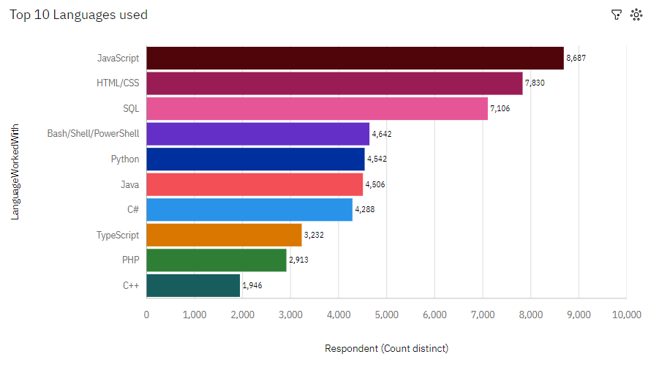
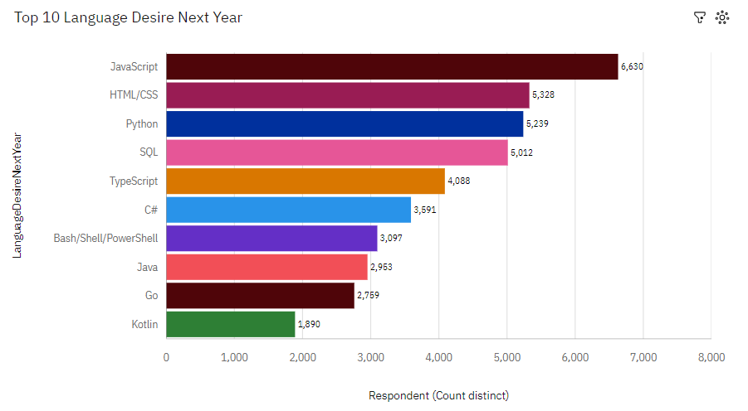
PROGRAMMING LANGUAGE TRENDS
Current Year
Next Year

Slide 8
PROGRAMMING LANGUAGE TRENDS - FINDINGS & IMPLICATIONS
Findings
Front-end languages JavaScript and HTML/CSS are consistently in demand
Python is the fastest growing, followed by typescript
Go and Kotlin reached the top 10
Implications
Possible developer’s migration from PHP and C++ to Go and Kotlin
Developers will consistently learn Python and Typescript

Slide 9
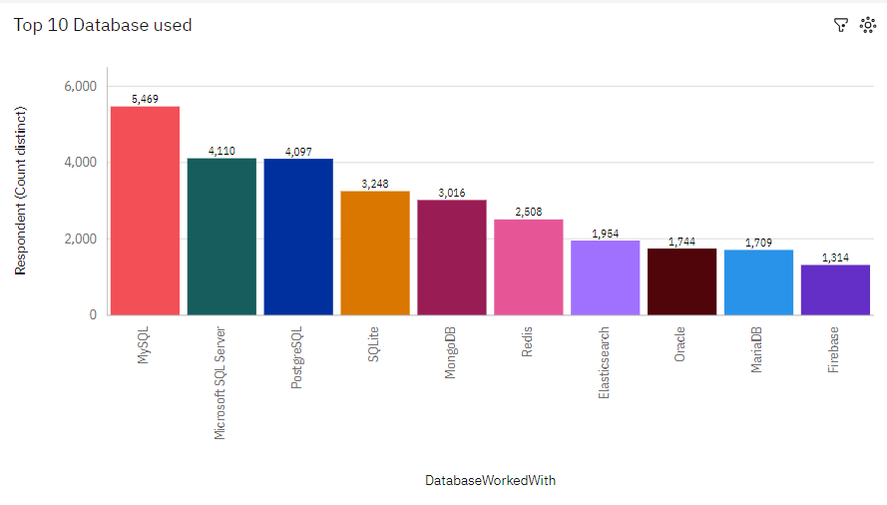
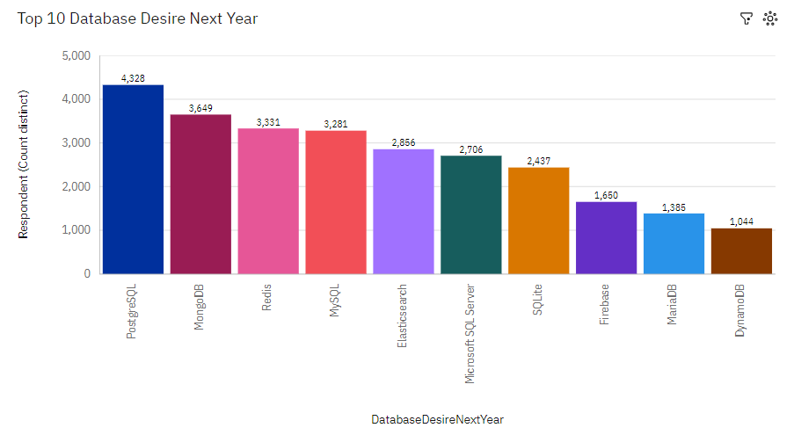
DATABASE TRENDS
Current Year
Next Year

Slide 10
DATABASE TRENDS - FINDINGS & IMPLICATIONS
Findings
MySQL as the most used database
PostgreSQL, MongoDB, and Redis were the most growing database language
Implications
More developers might start learning PostgreSQL, MongoDB, and Redis
MS SQL Server and SQLlite are losing market share

Slide 11

DASHBOARD
The GitHub link of the Cognos

Slide 12
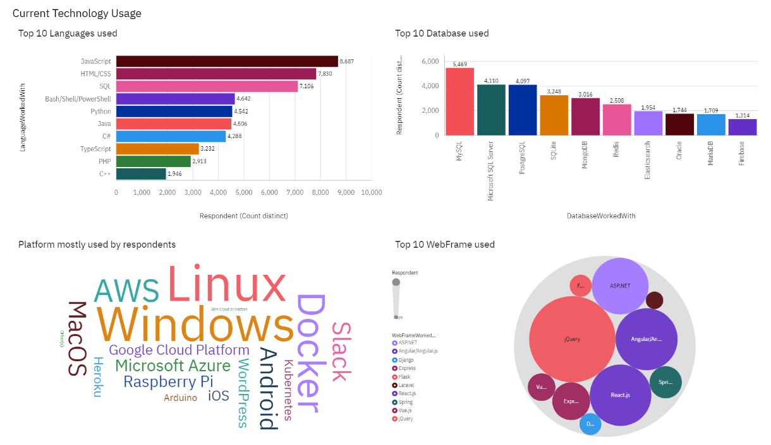
DASHBOARD TAB 1

Slide 13
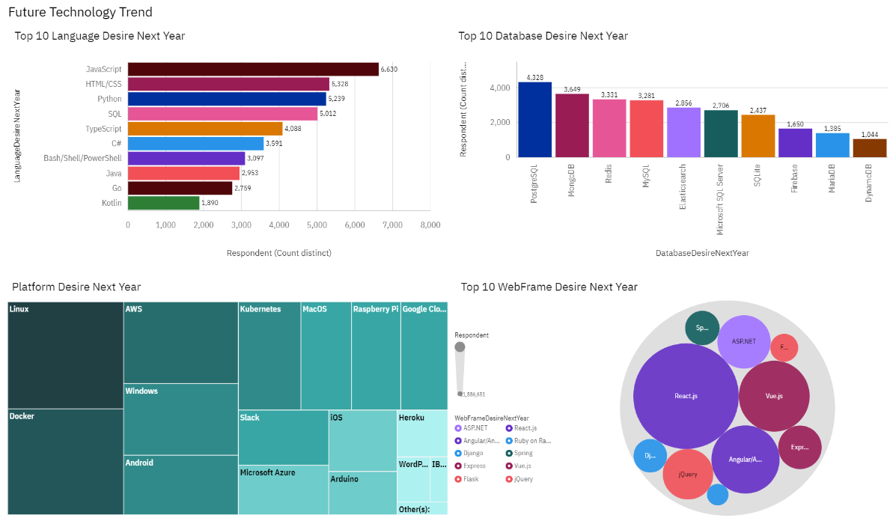
DASHBOARD TAB 2

Slide 14
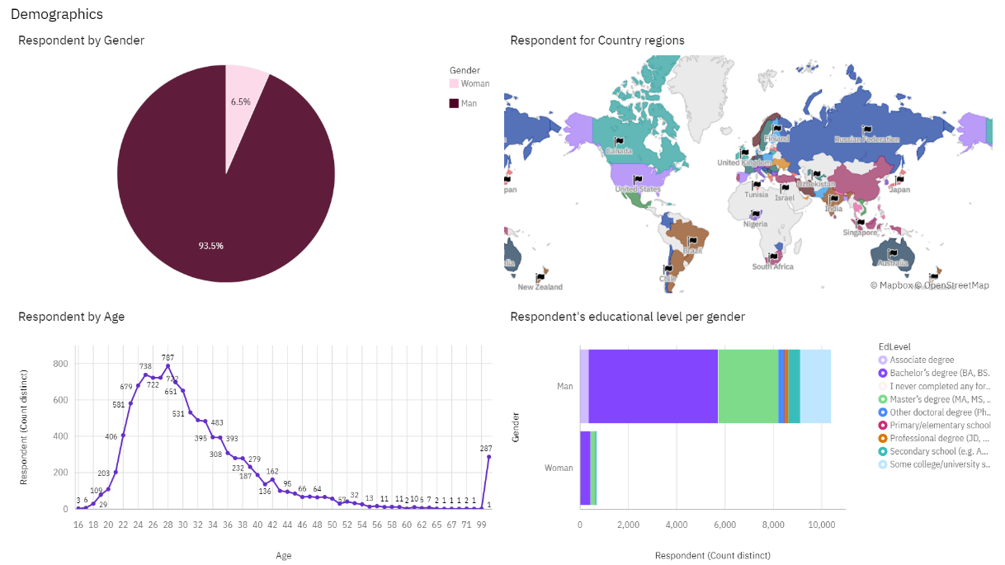
DASHBOARD TAB 3

Slide 15
DISCUSSION

Slide 16
OVERALL FINDINGS & IMPLICATIONS
Findings
Programming Language: JavaScript and HTML/ CSS remain widely used for Programming languages
Database: PostgreSQL, MongoDB and Redis are gaining market
Demographics: Over 90% of developers are young males.
Implications
Developers would continue still continue to use JavaScript and HTML/CSS
linux and docker are gaining more interest on the plaform used
On the webframe field, developers might migrate from Jquery to ReactJS

Slide 17

CONCLUSION
Distinct Profiles: Developers have well-defined characteristics.
Trend Analysis: Clear insights into the popularity of various tools, platforms, and languages can be gathered.
Accessibility Challenge: Efforts are needed to enhance access to this job market in developing countries.

Slide 18

APPENDIX

Slide 19
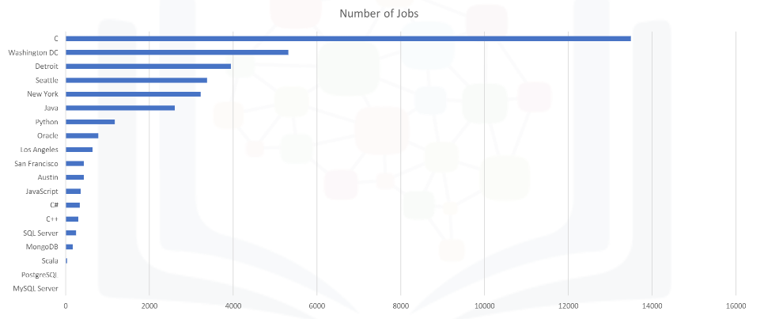
JOB POSTINGS
In Module 1 you have collected the job posting data using Job API in a file named “job-postings.xlsx”. Present that data using a bar chart here. Order the bar chart in the descending order of the number of job postings.

Slide 20
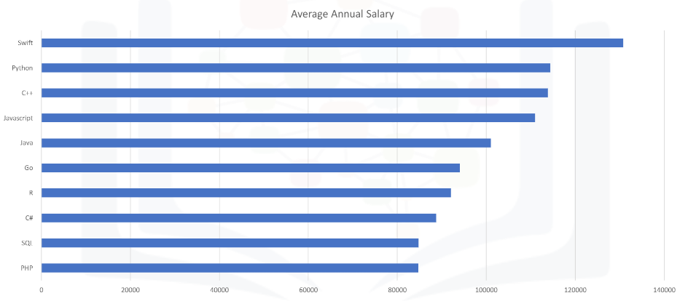
POPULAR LANGUAGES
In Module 1 you have collected the job postings data using web scraping in a file named “popular-languages.csv”. Present that data using a bar chart here. Order the bar chart in the descending order of salary.

